Slide 1
Moraga School District Citizen Bond Oversight Committee
September 27, 2017
District Report
Presented by Bruce K. Burns, Superintendent
~ Recent Activity ~ Next Steps ~ Accounting Update
Notes:
Recent Activity
Next Steps
Accounting Update

Slide 2
Update – Recent Activity I
Construction Manager Firm – RGM and Associates
Architectural Firm – CSDA Design Group
School Facilities Consultant – Williams and Associates
Coordinate with the Office of Public School Construction
Obtain and School Facility Program (SFP)eligibility records
Eligibility for SFP New Construction and/or Modernization Funds
Prepare and submit applications

Slide 3
Update – Recent Activity II
Construction/Architect/District meetings
6/16/17; 7/11/17; 8/1/17; 8/22/17; 9/2/17
Architect, Engineer, Construction Site Visits
Architect site meetings with staff, principal and parents
Attended Dept. of General Services workshop 9/25

Slide 4
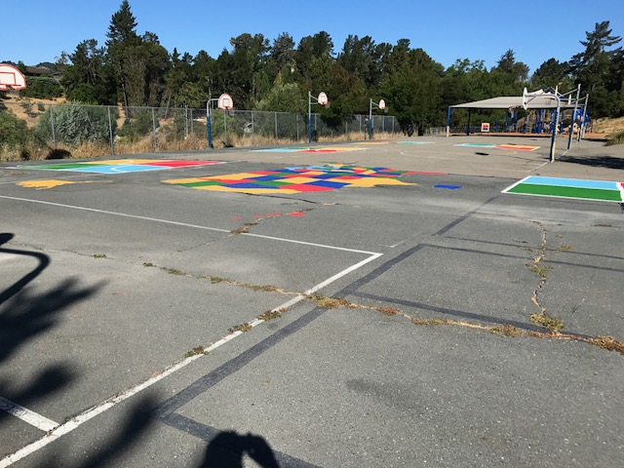
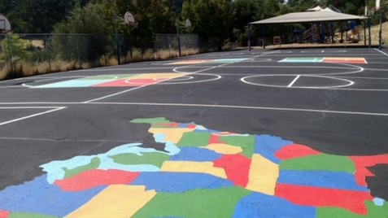
Update – Recent Activity IV
Projects to date:
Los Perales School Playground* Surface Repair, Reseal, Stripe
BEFORE
AFTER
*Ref: Appendix A, “Full Text of Bond Measure”, page A-3, School Facility Project List

Slide 5
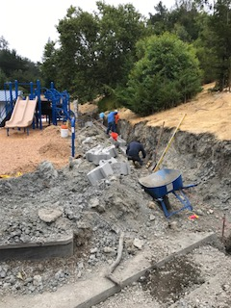
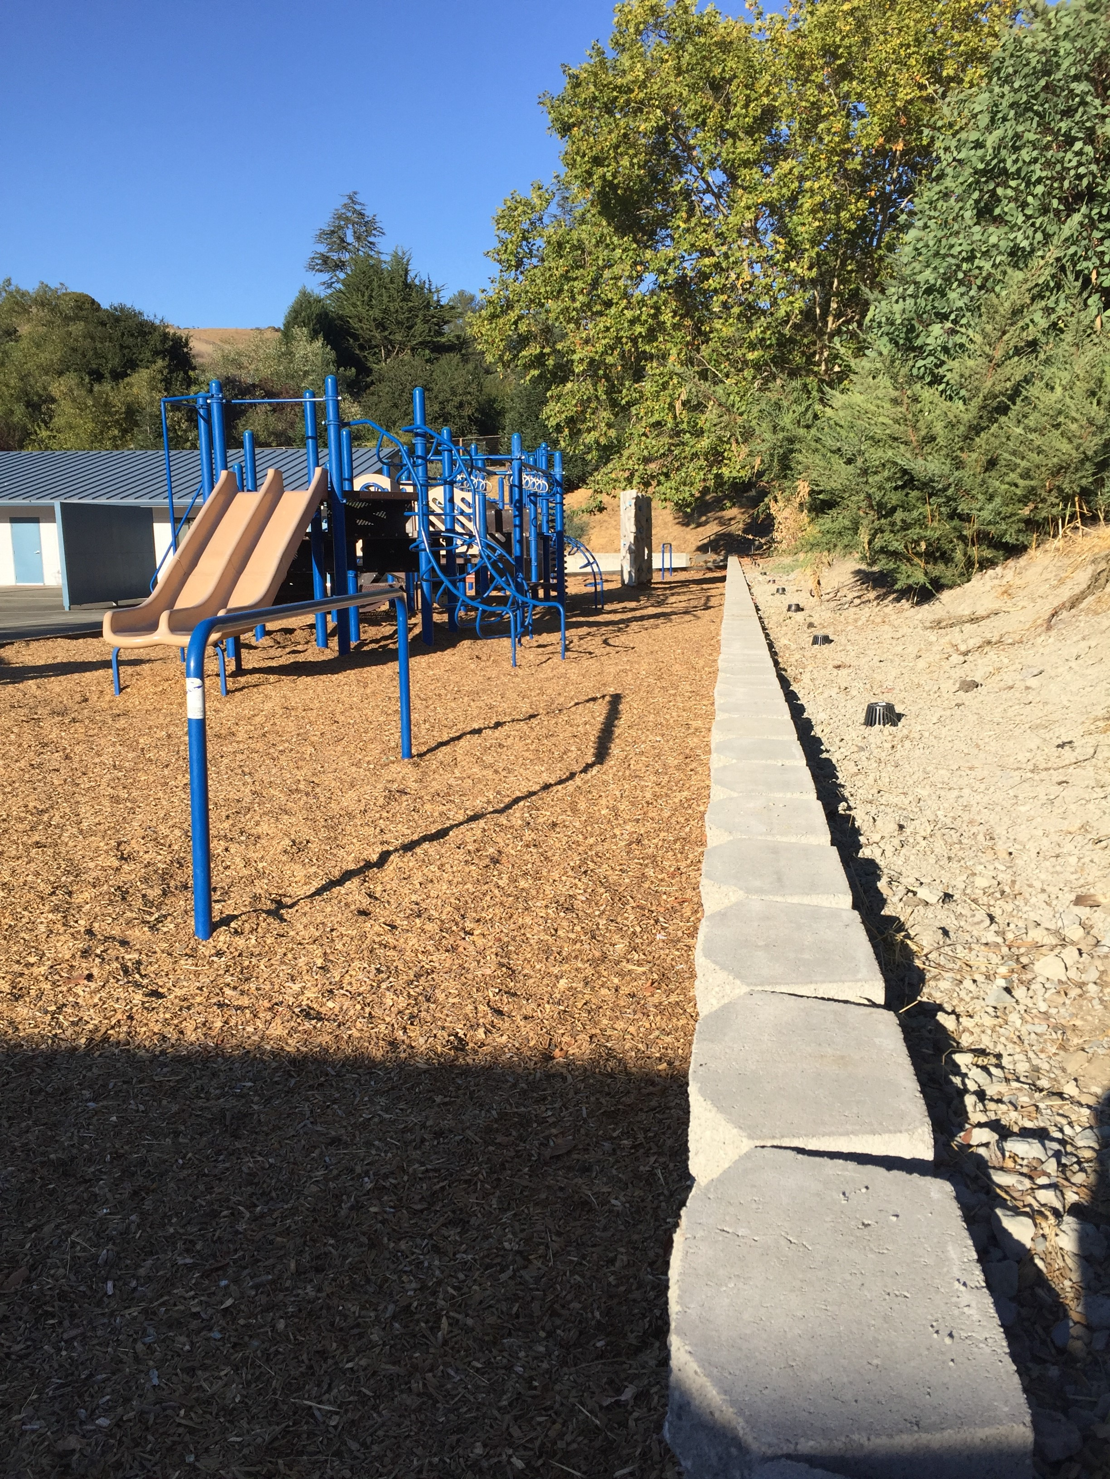
Update – Recent Activity III
“Quick Start” Projects to date:
Camino Pablo School Retaining Wall*, East Playground
*Ref: Appendix A, “Full Text of Bond Measure”, page A-3, School Facility Project List

Slide 6
Update – Recent Activity V
“Quick Start” Project – Roofing* Bids
Roof Replacement: Building G and Gym at JM & Wing 4 at RH
Public bidding process
12 Walked Sites/6 Bids
One roofing bid – for Building G only
Approved by Governing Board, 9/17
$192,000
Work begins in two weeks
*Ref: Appendix A, “Full Text of Bond Measure”, page A-3, School Facility Project List
Notes:
Expert roofer estimated

Slide 7
Next Steps
Construction Meeting at JM – Prepare for Roof Replacement
9/28/17
Site meetings continue
Information gathering and planning
Board presentation – January 2018
Projects/Costs/Options – presented by CSDA
Request for Proposal – Bond Auditor
Notes:
Expert roofer estimated

Slide 8
Accounting Update
PROJECT | BUDGET | ACTUALS | BALANCE
Available Bond Funds as of 07/01/2017: | $ 11,830,000 | $ 11,830,000 | $ -
Expenditures:
Quickstart-LP Seal, Coat, Stripe | $ 11,750 | $ 11,750 | $ -
Quickstart-CP Wall Project | $ 15,803 | $ 15,803 | $ -
*PENDING
RGM Contract (Construction Management Firm) | $ 188,600 | $ - | $ 188,600
CSDA Contract (Architect Contract) | $ 75,000 |  | $ 75,000
Williams & Associates-Facilities Financial Consultant | $ 27,880 | $ - | $ 27,880
Quickstart-JM Re-roofing Building G | $ 192,000 | $ - | $ 192,000
Total Expenditures: | $ 511,033 | $ 27,553 | $ 483,480
TOTAL: | $ 11,318,967 | $ 11,802,447
*CONTRACTS HAVE BEEN APPROVED BUT HAVE NOT YET BEEN PROCESSED IN THE SYSTEM
Notes:
Expert roofer estimated

